Slide 1

BEST INVESTMENT OPTIONS
By ARUN KOTHLAPUR

Slide 2
What is investing?
Investing in a simplified manner money makes money, time is money.
Proper instrument, analyse, growth aspects, patience, etc.
Every person investing in, one of the options depending upon their understanding and savings.

Slide 3
Investing options?
Saving account .(2.7% - 3% pa)
Bank Fixed Deposit.(5.75% - 6.75% pa)
Gold (50,000 rupees fluctuates)
Mutual funds(10% - 15 % pa depends on risk factor)
Stock Market ( high risk- analysis needed, long term investing)
Real Estate ( investing land is best always appreciates)

Slide 4
Real estate vs other returns
Short term (5-7 yr)
Mid term (7-12 yr)
Long term(12yr +)
Corona time stocks collapse, companies collapse, unemployment, recession.
Where the money has flown?

Slide 5
Why real estate?
Real estate deals with Land, industrial land, Commercial Land, Agriculture land.
Evergreen.
Land always appreciates depending upon the nearby developments it increases faster or slower but always appreciates.
Land is fixed matter it neither be created nor destroyed.
Journey from birth->childhood-> education-> Job->savings,basic requirements(bike,tv,etc)->future (Land,house,flat,etc.)

Slide 6
Growing Hyderabad.
Hyderabad is a city where the migration of 2.5% increase and population increase of 2.5% every year.
Currently 1.02 crore Population (2021)
Growing City, increase in population , their 3 basic requirements(food ,clothing, shelter)
For Food and clothing fulfil in less money, but shelter people prefer rent.

Slide 7
Developments.
Many Indian companies as well as Foreign companies and investors are interested to invest in the growing cities like Hyderabad.
But they require more land as well so, the only option for them is establish in a large area i.e. outskirts of Hyderabad.
This is the first step in growing land prices, because as company is established -> recruitment-> public-> public needs 3 basic requirements-> commercial complexes ->there by land value increases.

Slide 8
Past growth vs. expected growth
For the last 10 yrs. say 2011 to 2021, enormous growth has been seen, because of the new state formation Telangana in 2014,many IT companies are interested to start new companies, excellent infrastructure, roads and railways connecting all major cities and states.
Inner ring road, Outer ring road and Currently plans for Regional Ring road(RRR)
For next 10 yr. (2021 – 2031) this growth may expect very fast as population is exponential so more people, more needs, more land require, more demand, land prices increase.so finally we can expect at least 4x returns for next 10 yr.

Slide 9
Why BBG?
BBG( Building Blocks Group) is a realty company specially in Land plotting investment.
BBG company is 15 yr. old company with 1,70,000+ Happy Customers all over the world.
Currently 3 offices in Hyderabad in jntu, jublihills, lb nagar.
U70100TG2015PTC099221 ( cin in telangana 2015)
Company vision 10,00,000 plots sale and 10,00,000 girls care.

Slide 10
Benefits of BBG customer.
Complete online layout, booking, availability, etc.
Best customer service for site visit, proper response from the team.
10 yr. society monitoring (best)
Expect High returns because of R&D.
Gated Comminity,24x7 Security, drinking water, drainage system, block top roads, rainwater harvesting, electricity, parks and garden, avenue plantation, etc.

Slide 11
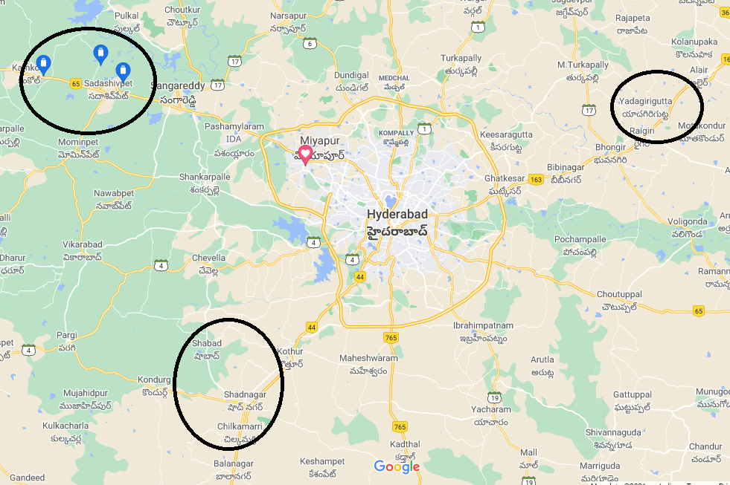
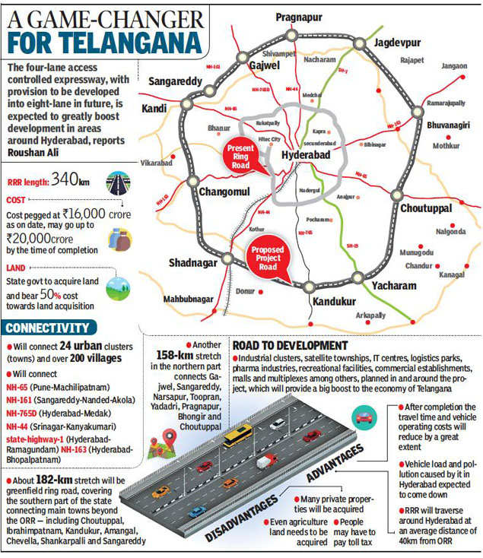

Slide 12
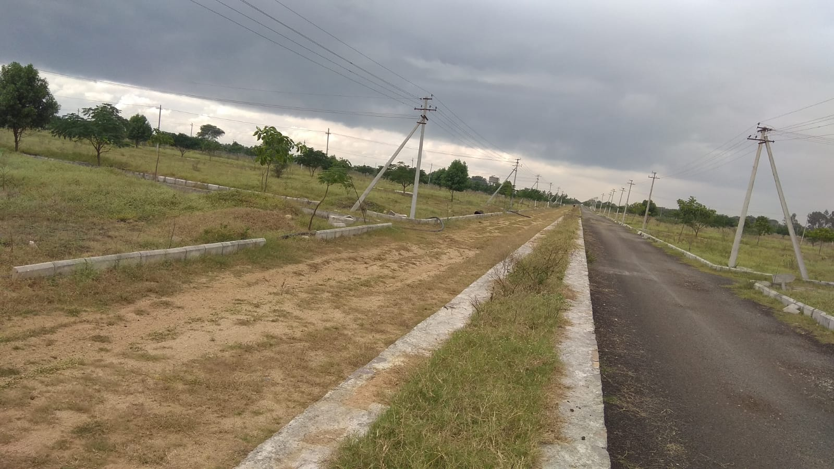
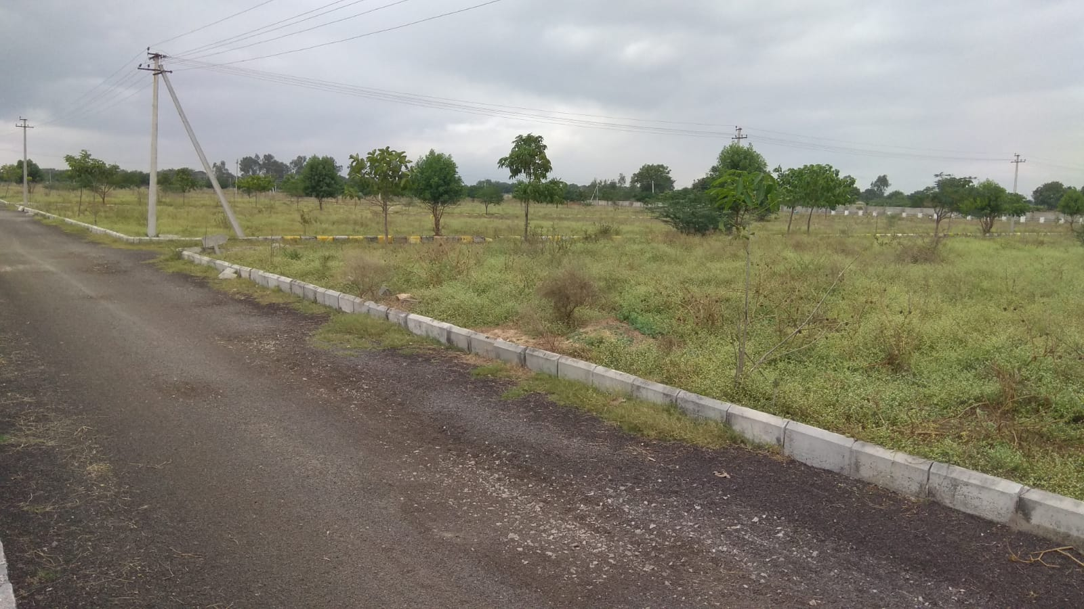
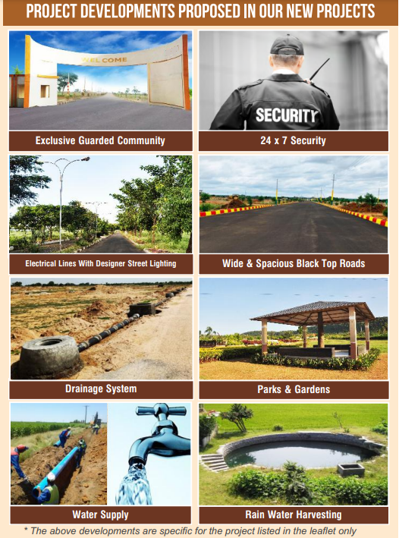
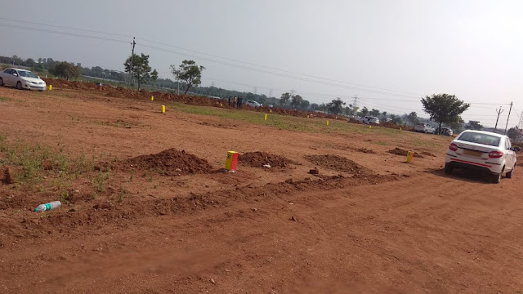
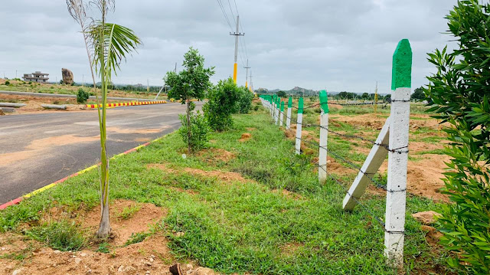
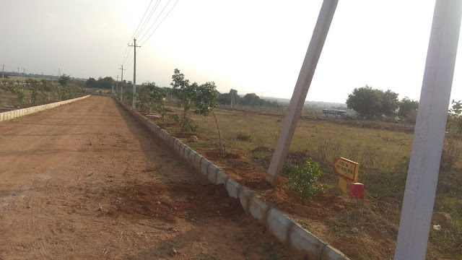
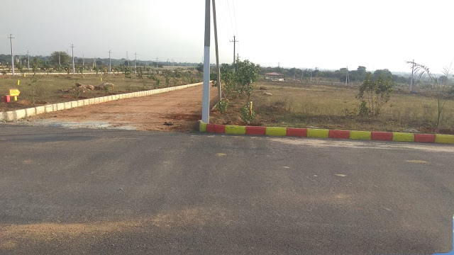
Current & Future Developments

Slide 13
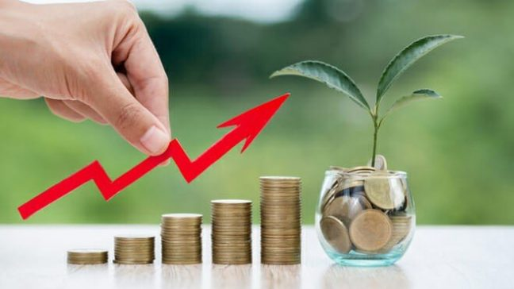
Why late? Think Now and Act wise.

Slide 14

Queries?

Slide 15

Thank you

Slide 17
Budget?

Slide 18
Facing?

Slide 19
Payment?

